Slide 1
Loblaw Data Science
Siddharth Goradia

Slide 2
Part A

Slide 3
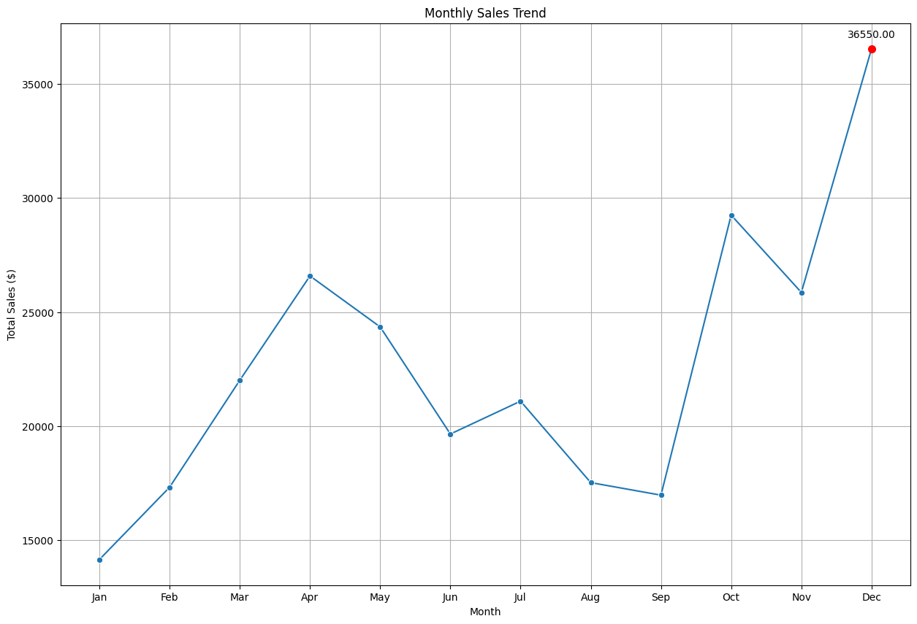
Sales Trend Insights
Seasonal Sales Growth in December
Key Insights
December has the highest sales indicating seasonal trends (Likely due to the holiday season)
Action Steps
Increase Inventory during Holiday Season
Offer holiday discounts and targeted marketing campaigns

Slide 4
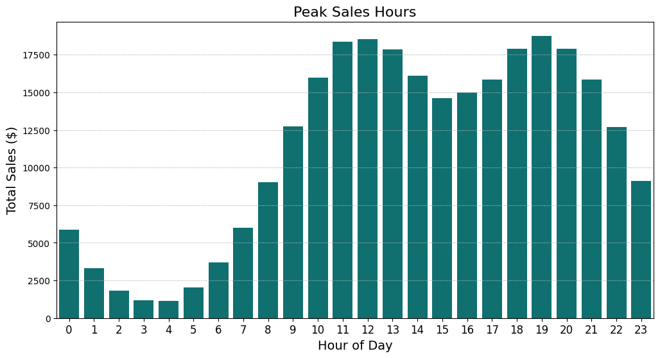
Peak Sales Hour
Optimal Sales Hour
Key Insights
Peak sales occurs between 11am - 1pm and 6 pm - 8 pm
Lowest sales in the morning
Action Steps
Schedule promotions during peak hours
Make staffing changes during peak sales

Slide 5
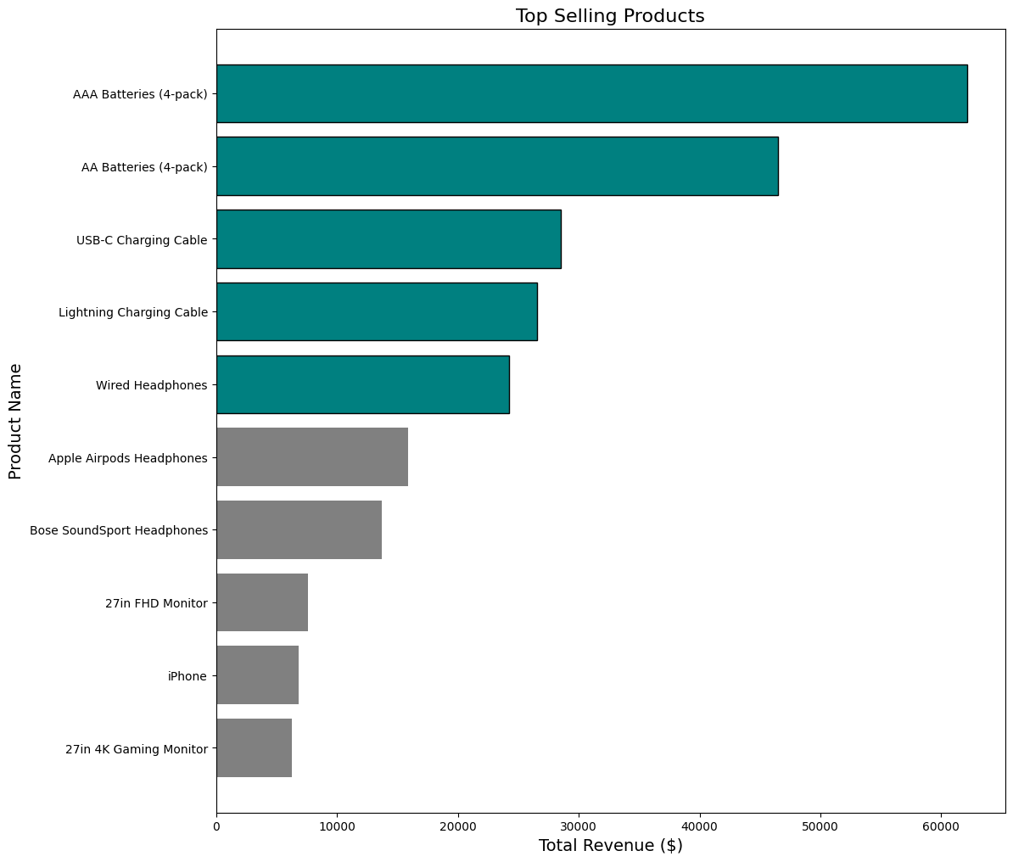
Best Selling Products
Maximizing Revenue with Popular Products
Key Insights
Batteries are the best selling products
Top 10 items are from electronics department
Action Steps
Offer bundle offers
Optimize product placement for impulsive buying

Slide 6
Top 5 Sales Quantity Prediction Model
Created 5 models for sales prediction of the top 5 selling products in dollar value
Key Findings
Random Forest provided robust performance across most products, with low MAE and RMSE.
Time-based features (day, month, week, day-of-week, weekend indicator) combined with lag and rolling features to capture trends.
Actionable Insight
Use the sales prediction to optimize inventory level
Identify seasonal trends and adjust marketing campaigns to boost sales further.

Slide 7
Part B

